Slide 1
Crime against Children and Women
Q4Which state has more crime against children and women?
Query:-
SELECT a.STATES,
sum(a.Total_crimes_againschild) as crimes_agains_child,
sum(b.KidnappingandAbduction + b.DowryDeaths +b.Assaultonwomenwithintenttooutragehermodesty +b. InsulttomodestyofWomen +b.CrueltybyHusbandorhisRelatives + b.ImportationofGirls + b.Rape )as Total_Crimes_on_Women
FROM "03_District_wise_crimes_committed_against_children_2001_2013" as a
INNER JOIN "42_District_wise_crimes_committed_against_women_2001_2013" as b
on a.STATES=b.STATES
GROUP by a.STATES;

Slide 2
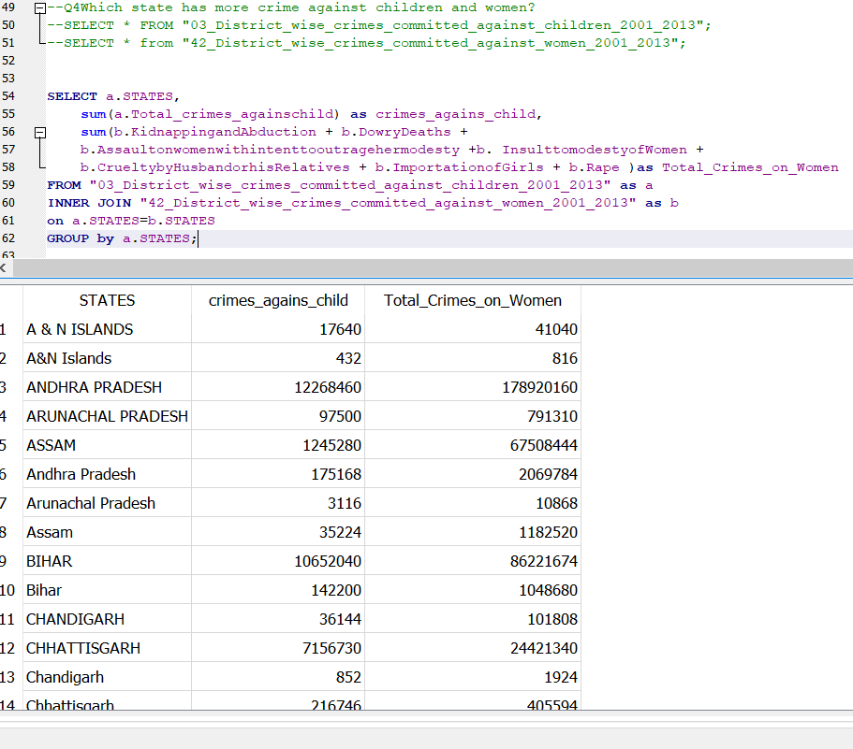
Our query screenshot:-

Slide 3
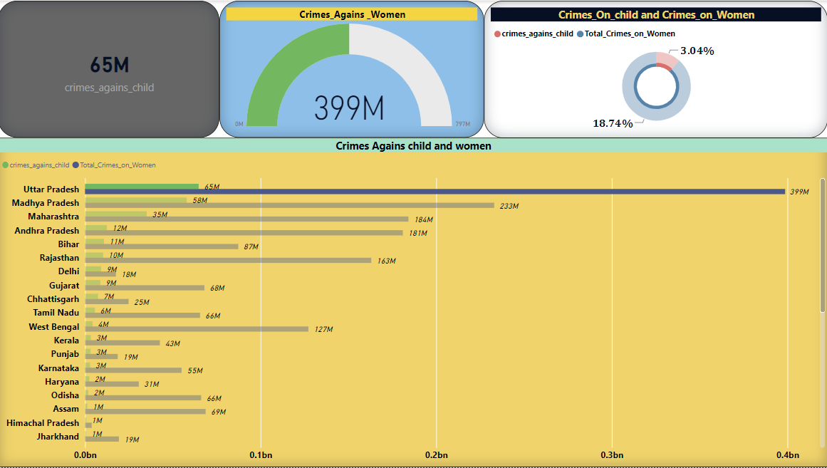
Conclusion:- 1. ﻿Uttar Pradesh accounted for 26.47% of crimes_agains_child. 2 . ﻿Total_Crimes_on_Women and crimes_agains_child diverged the most when the STATES was Uttar Pradesh, when Total_Crimes_on_Women were 333944640 higher than crimes_agains_child.

